Slide 1
Computer
Organization
Prepared By:-
Parminder Mann

Slide 2
OBJECTIVES
After reading this chapter, the reader should be able to:
Distinguish between the three components of a computer hardware.
List the functionality of each component.
Understand memory addressing and calculate the number of bytes for a specified purpose.
Distinguish between different types of memories.
Understand how each input/output device works.

Slide 4
GENERAL REGISTER ORGANISATION

Slide 5
ADDRESSING MODES
Addressing Modes:
* Specifies a rule for interpreting or modifying the
address field of the instruction (before the operand
is actually referenced)
* Variety of addressing modes
- to give programming flexibility to the user
- to use the bits in the address field of the
instruction efficiently

Slide 6
TYPES OF ADDRESSING MODES
Implied Mode
Address of the operands are specified implicitly
in the definition of the instruction
- No need to specify address in the instruction
- EA = AC, or EA = Stack[SP], EA: Effective Address.
Immediate Mode
Instead of specifying the address of the operand,
operand itself is specified
- No need to specify address in the instruction
- However, operand itself needs to be specified
- Sometimes, require more bits than the address
- Fast to acquire an operand
Register Mode
Address specified in the instruction is the register address
- Designated operand need to be in a register
- Shorter address than the memory address
- Saving address field in the instruction
- Faster to acquire an operand than the memory addressing
- EA = IR(R) (IR(R): Register field of IR)

Slide 7
TYPES OF ADDRESSING MODES
Register Indirect Mode
Instruction specifies a register which contains
the memory address of the operand
- Saving instruction bits since register address
is shorter than the memory address
- Slower to acquire an operand than both the
register addressing or memory addressing
- EA = [IR(R)] ([x]: Content of x)
Auto-increment or Auto-decrement features:
Same as the Register Indirect, but:
- When the address in the register is used to access memory, the value in the register is incremented or decremented by 1 (after or before the execution of the instruction)

Slide 8
TYPES OF ADDRESSING MODES
Direct Address Mode
Instruction specifies the memory address which
can be used directly to the physical memory
- Faster than the other memory addressing modes
- Too many bits are needed to specify the address
for a large physical memory space
- EA = IR(address), (IR(address): address field of IR)
Indirect Addressing Mode
The address field of an instruction specifies the address of a memory location that contains the address of the operand
- When the abbreviated address is used, large physical memory can be addressed with a relatively small number of bits
- Slow to acquire an operand because of an additional memory access
- EA = M[IR(address)]

Slide 9
PROGRAM INTERRUPT
Types of Interrupts:
External interrupts
External Interrupts initiated from the outside of CPU and Memory
- I/O Device -> Data transfer request or Data transfer complete
- Timing Device -> Timeout
- Power Failure
Internal interrupts (traps)
Internal Interrupts are caused by the currently running program
- Register, Stack Overflow
- Divide by zero
- OP-code Violation
- Protection Violation
Software Interrupts
Both External and Internal Interrupts are initiated by the computer Hardware.
Software Interrupts are initiated by texecuting an instruction.
- Supervisor Call -> Switching from a user mode to the supervisor mode
-> Allows to execute a certain class of operations
which are not allowed in the user mode

Slide 10
RISC: REDUCED INSTRUCTION SET COMPUTERS
Historical Background
IBM System/360, 1964
- The real beginning of modern computer architecture
- Distinction between Architecture and Implementation
- Architecture: The abstract structure of a computer
seen by an assembly-language programmer
Compiler
μ-program
High-Level
Language
Instruction
Set
Hardware
Architecture
Implementation
Continuing growth in semiconductor memory and microprogramming
-> A much richer and complicated instruction sets
=> CISC(Complex Instruction Set Computer)
- Arguments advanced at that time
Richer instruction sets would simplify compilers
Richer instruction sets would alleviate the software crisis
- move as much functions to the hardware as possible
- close Semantic Gap between machine language
and the high-level language
Richer instruction sets would improve the architecture quality

Slide 11
CHARACTERISTICS OF RISC
Common RISC Characteristics
- Operations are register-to-register, with only LOAD and STORE accessing memory
- The operations and addressing modes are reduced
Instruction formats are simple
More characteristics are as:
- Relatively few instructions
- Relatively few addressing modes
- Memory access limited to load and store instructions
- All operations done within the registers of the CPU
- Fixed-length, easily decoded instruction format
- Single-cycle instruction format
- Hardwired rather than microprogrammed control

Slide 12
COMPLEX INSTRUCTION SET COMPUTERS: CISC
High Performance General Purpose Instructions
Characteristics of CISC:
A large number of instructions (from 100-250 usually)
Some instructions that performs a certain tasks are not used frequently.
Many addressing modes are used (5 to 20)
Variable length instruction format.
Instructions that manipulate operands in memory.

Slide 13
MAJOR COMPONENTS OF CPU
Storage Components:
Registers
Flip-flops
Execution (Processing) Components:
Arithmetic Logic Unit (ALU):
Arithmetic calculations, Logical computations, Shifts/Rotates
Transfer Components:
Bus
Control Components:
Control Unit
Register
File
ALU
Control Unit

Slide 14
MEMORY STACK ORGANIZATION
1000
Memory with Program, Data,
and Stack Segments
PC
Program
(instructions)
AR
Data
(operands)
SP
3000
stack
3997
3998
3999
- A portion of memory is used as a stack with a
processor register as a stack pointer
- PUSH: SP ← SP - 1
M[SP] ← DR
- POP: DR ← M[SP]
SP ← SP + 1
- Most computers do not provide hardware to check
stack overflow (full stack) or underflow(empty stack)
4000
4001
DR

Slide 15
INSTRUCTION FORMAT
Instruction Fields
OP-code field - specifies the operation to be performed
Address field - designates memory address(s) or a processor register(s)
Mode field - specifies the way the operand or the
effective address is determined
The number of address fields in the instruction format
depends on the internal organization of CPU
- The three most common CPU organizations:
Single accumulator organization:
ADD X /* AC ← AC + M[X] */
General register organization:
ADD R1, R2, R3 /* R1 ← R2 + R3 */
ADD R1, R2 /* R1 ← R1 + R2 */
MOV R1, R2 /* R1 ← R2 */
ADD R1, X /* R1 ← R1 + M[X] */
Stack organization:
PUSH X /* TOS ← M[X] */
ADD

Slide 16
THREE, and TWO-ADDRESS INSTRUCTIONS
Three-Address Instructions:
Program to evaluate X = (A + B) * (C + D) :
ADD R1, A, B /* R1 ← M[A] + M[B] */
ADD R2, C, D /* R2 ← M[C] + M[D] */
MUL X, R1, R2 /* M[X] ← R1 * R2 */
- Results in short programs
- Instruction becomes long (many bits)
Two-Address Instructions:
Program to evaluate X = (A + B) * (C + D) :
MOV R1, A /* R1 ← M[A] */
ADD R1, B /* R1 ← R1 + M[B] */
MOV R2, C /* R2 ← M[C] */
ADD R2, D /* R2 ← R2 + M[D] */
MUL R1, R2 /* R1 ← R1 * R2 */
MOV X, R1 /* M[X] ← R1 */

Slide 17
ONE, and ZERO-ADDRESS INSTRUCTIONS
One-Address Instructions:
- Use an implied AC register for all data manipulation
- Program to evaluate X = (A + B) * (C + D) :
LOAD A /* AC ← M[A] */
ADD B /* AC ← AC + M[B] */
STORE T /* M[T] ← AC */
LOAD C /* AC ← M[C] */
ADD D /* AC ← AC + M[D] */
MUL T /* AC ← AC * M[T] */
STORE X /* M[X] ← AC */
Zero-Address Instructions:
- Can be found in a stack-organized computer
- Program to evaluate X = (A + B) * (C + D) :
PUSH A /* TOS ← A */
PUSH B /* TOS ← B */
ADD /* TOS ← (A + B) */
PUSH C /* TOS ← C */
PUSH D /* TOS ← D */
ADD /* TOS ← (C + D) */
MUL /* TOS ← (C + D) * (A + B) */
POP X /* M[X] ← TOS */

Slide 18
Multiprocessor
A multiprocessor is a computer system with two or more central processing units (CPUs), with each one sharing the common main memory as well as the peripherals. This helps in simultaneous processing of programs.
The key objective of using a multiprocessor is to boost the system’s execution speed, with other objectives being fault tolerance and application matching.
Benefits of using a multiprocessor include:
Enhanced performance
Multiple applications
Multiple users
Multi-tasking inside an application
High throughput and/or responsiveness
Hardware sharing among CPUs

Slide 19
Different ways of using a multiprocessor
As a uniprocessor, such as single instruction, single data (SISD)
Inside a single system for executing multiple, individual series of instructions in multiple perspectives, such as multiple instruction, multiple data (MIMD)
A single series of instructions in various perspectives, such as single instruction, multiple data (SIMD), which is usually used for vector processing
Multiple series of instructions in a single perspective, such as multiple instruction, single data (MISD), which is used for redundancy in failsafe systems and, occasionally, for describing hyper-threading or pipelined processors

Slide 20
Pipelining
Pipelining is the process of accumulating instruction from the processor through a pipeline. It allows storing and executing instructions in an orderly process. It is also known as pipeline processing.
Pipelining is a technique where multiple instructions are overlapped during execution. Pipeline is divided into stages and these stages are connected with one another to form a pipe like structure. Instructions enter from one end and exit from another end.
Pipelining increases the overall instruction throughput.
In pipeline system, each segment consists of an input register followed by a combinational circuit. The register is used to hold data and combinational circuit performs operations on it. The output of combinational circuit is applied to the input register of the next segment.

Slide 21
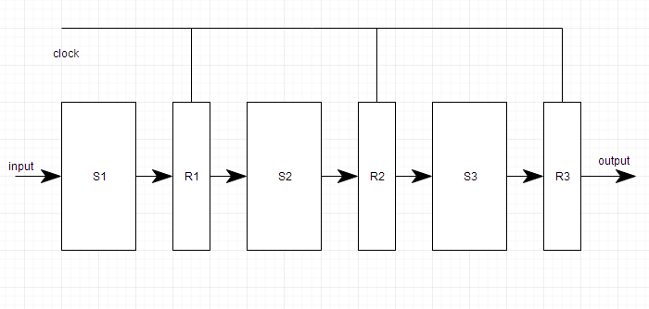
Pipeline system is like the modern day assembly line setup in factories. For example in a car manufacturing industry, huge assembly lines are setup and at each point, there are robotic arms to perform a certain task, and then the car moves on ahead to the next arm.

Slide 22
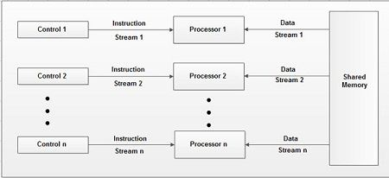
MIMD Computers
MIMD computers are consisting of 'n' processing units; each with its own stream of instruction and each processing unit operate on unit operates on a different piece of data. MIMD is the most powerful computer system that covers the range of multiprocessor systems. The block diagram of MIMD computer is shown.

Slide 23
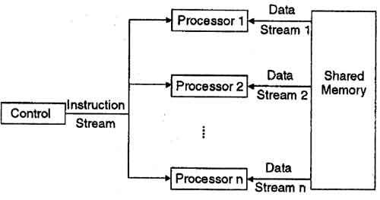
SIMD Computers
SIMD computers are consisting of ‘n' processing units receiving a single stream of instruction from a central control unit and each processing unit operates on a different piece of data. Most SIMD computers operate synchronously using a single global dock. The block diagram of SIMD computer is shown below:

Slide 24
THANK YOU

