Slide 1
DATABASE MANAGEMENT SYSTEM
Notes:
The slides for this text are organized into chapters. This lecture covers Chapter 1.
Chapter 1: Introduction to Database Systems
Chapter 2: The Entity-Relationship Model
Chapter 3: The Relational Model
Chapter 4 (Part A): Relational Algebra
Chapter 4 (Part B): Relational Calculus
Chapter 5: SQL: Queries, Programming, Triggers
Chapter 6: Query-by-Example (QBE)
Chapter 7: Storing Data: Disks and Files
Chapter 8: File Organizations and Indexing
Chapter 9: Tree-Structured Indexing
Chapter 10: Hash-Based Indexing
Chapter 11: External Sorting
Chapter 12 (Part A): Evaluation of Relational Operators
Chapter 12 (Part B): Evaluation of Relational Operators: Other Techniques
Chapter 13: Introduction to Query Optimization
Chapter 14: A Typical Relational Optimizer
Chapter 15: Schema Refinement and Normal Forms
Chapter 16 (Part A): Physical Database Design
Chapter 16 (Part B): Database Tuning
Chapter 17: Security
Chapter 18: Transaction Management Overview
Chapter 19: Concurrency Control
Chapter 20: Crash Recovery
Chapter 21: Parallel and Distributed Databases
Chapter 22: Internet Databases
Chapter 23: Decision Support
Chapter 24: Data Mining
Chapter 25: Object-Database Systems
Chapter 26: Spatial Data Management
Chapter 27: Deductive Databases
Chapter 28: Additional Topics

Slide 2
Basic Definitions
Database:
A logical coherent collection of data representing the mini-world such that change in the mini-world brings about change in database collected for a particular purpose and for a group of intended users.
Data:
Meaningful facts, text, graphics, images, sound, video segments that can be recorded and have an implicit meaning.
Metadata:
Data that describes data
File Processing System
A collection of application programs that perform services for the end-users such as production of reports
Each program defines and manages its own data
Database Management System (DBMS):
A software package/ system to facilitate the creation and maintenance of a computerized database.
Database System:
The DBMS software together with the data itself. Sometimes, the applications are also included. Database + DBMS

Slide 3
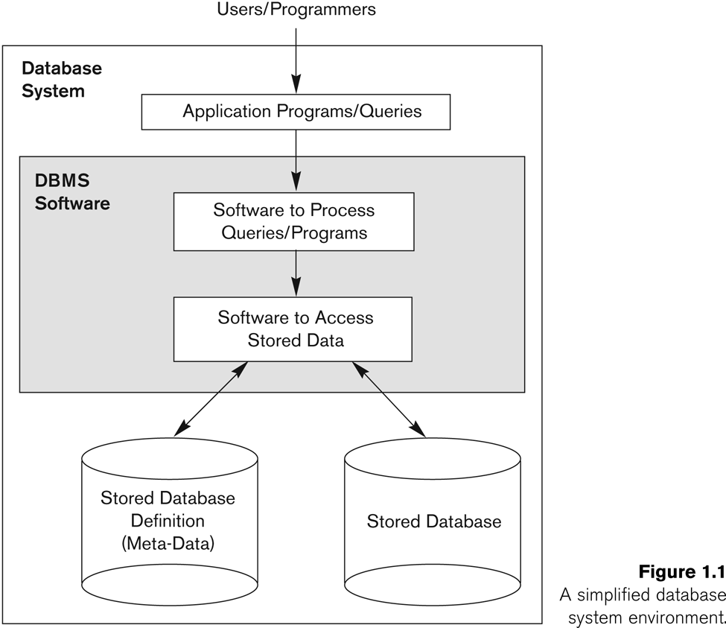
Simplified database system environment

Slide 4
Evolution of DB Systems
Flat files - 1960s - 1980s
Hierarchical – 1970s - 1990s
Network – 1970s - 1990s
Relational – 1980s - present
Object-oriented – 1990s - present
Object-relational – 1990s - present
Data warehousing – 1980s - present
Web-enabled – 1990s - present

Slide 5
Purpose of Database Systems
Database management systems were developed to handle the difficulties of typical file-processing systems supported by conventional operating systems

Slide 6
Disadvantages of File Processing
Program-Data Dependence
File structure is defined in the program code.
All programs maintain metadata for each file they use
Duplication of Data (Data Redundancy)
Different systems/programs have separate copies of the same data
Same data is held by different programs.
Wasted space and potentially different values and/or different formats for the same item.
Limited Data Sharing
No centralized control of data
Programs are written in different languages, and so cannot easily access each other’s files.
Lengthy Development Times
Programmers must design their own file formats
Excessive Program Maintenance
80% of of information systems budget
Vulnerable to Inconsistency
Change in one table need changes in corresponding tables as well otherwise data will be inconsistent

Slide 7
Advantages of Database Approach
Data independence and efficient access.
Data integrity and security.
Uniform data administration.
Concurrent access, recovery from crashes.
Replication control
Reduced application development time.
Improved Data Sharing
Different users get different views of the data
Enforcement of Standards
All data access is done in the same way
Improved Data Quality
Constraints, data validation rules
Better Data Accessibility/ Responsiveness
Use of standard data query language (SQL)
Security, Backup/Recovery, Concurrency
Disaster recovery is easier

Slide 8
Costs and Risks of the Database Approach
Up-front costs:
Installation Management Cost and Complexity
Conversion Costs
Ongoing Costs
Requires New, Specialized Personnel
Need for Explicit Backup and Recovery
Organizational Conflict
Old habits die hard

Slide 9
Database Applications
Database Applications:
Banking: all transactions
Airlines: reservations, schedules
Universities: registration, grades
Sales: customers, products, purchases
Manufacturing: production, inventory, orders, supply chain
Human resources: employee records, salaries, tax deductions
Databases touch all aspects of our lives

Slide 10
Levels of Abstraction
Many views, single conceptual (logical) schema and physical schema.
Views describe how users see the data.
Conceptual schema defines logical structure
Physical schema describes the files and indexes used.
View 1
View 2
View 3
Conceptual Schema
Physical Schema
Schemas are defined using DDL; data is modified/queried using DML.
Notes:
6

Slide 11
Example: University Database
Conceptual schema:
Students(sid: string, name: string, login: string,
age: integer, gpa:real)
Courses(cid: string, cname:string, credits:integer)
Enrolled(sid:string, cid:string, grade:string)
Physical schema:
Relations stored as unordered files.
Index on first column of Students.
External Schema (View):
Course_info(cid:string, enrollment:integer)
Notes:
7

Slide 12
Instances and Schemas
Similar to types and variables in programming languages
Schema – the logical structure of the database (e.g., set of customers and accounts and the relationship between them)
Instance – the actual content of the database at a particular point in time

Slide 13
Data Independence
Ability to modify a schema definition in one level without affecting a schema definition in the other levels.
The interfaces between the various levels and components should be well defined so that changes in some parts do not seriously influence others.
Two levels of data independence
Physical data independence:- Protection from changes in logical structure of data.
Logical data independence:- Protection from changes in physical structure of data.

Slide 14
Instances and Schemas
Similar to types and variables in programming languages
Schema – the logical structure of the database
e.g., the database consists of information about a set of customers and accounts and the relationship between them)
Analogous to type information of a variable in a program
Physical schema: database design at the physical level
Logical schema: database design at the logical level
Instance – the actual content of the database at a particular point in time
Analogous to the value of a variable
Physical Data Independence – the ability to modify the physical schema without changing the logical schema
Applications depend on the logical schema
In general, the interfaces between the various levels and components should be well defined so that changes in some parts do not seriously influence others.

Slide 15
Database Languages
Data Definition Language (DDL)
Specification notation for defining the database schema
DDL compiler generates a set of tables stored in a data dictionary
Data dictionary contains metadata (data about data)
Data storage and definition language – special type of DDL in which the storage structure and access methods used by the database system are specified
Data Manipulation Language (DML)
Language for accessing and manipulating the data organized by the appropriate data model
Two classes of languages
Procedural – user specifies what data is required and how to get those data
Nonprocedural – user specifies what data is required without specifying how to get those data

Slide 16
Database Users
Users are differentiated by the way they expect to interact with the system
Application programmers – interact with system through DML calls
Sophisticated users – form requests in a database query language
Specialized users – write specialized database applications that do not fit into the traditional data processing framework
Naïve users – invoke one of the permanent application programs that have been written previously
E.g. people accessing database over the web, bank tellers, clerical staff

Slide 17
Database Administrator
Coordinates all the activities of the database system; the database administrator has a good understanding of the enterprise’s information resources and needs.
Database administrator's duties include:
Schema definition
Storage structure and access method definition
Schema and physical organization modification
Granting user authority to access the database
Specifying integrity constraints
Acting as liaison with users
Monitoring performance and responding to changes in requirements

Slide 18
Data Models
A collection of tools for describing:
Data
Data relationships
Data semantics
Data constraints
Object-based logical models
Entity-relationship model
Object-oriented model
Semantic model
Functional model
Record-based logical models
Relational model (e.g., SQL/DS, DB2)
Network model
Hierarchical model (e.g., IMS)

Slide 19
Entity-Relationship Model
The basics of Entity-Relationship modelling
Entities (objects)
E.g. customers, accounts, bank branch
Attributes
Relationships between entities
E.g. Account A-101 is held by customer Johnson
Relationship set depositor associates customers with accounts
Widely used for database design
Database design in E-R model usually converted to design in the relational model which is used for storage and processing

Slide 20
ER Model Basics
name
ssn
lot
Employees
Entity: Real-world object distinguishable from other objects. An entity is described using a set of attributes. Each attribute has a domain.
Entity Set: A collection of similar entities. E.g., all employees.
All entities in an entity set have the same set of attributes. (Until we consider ISA hierarchies, anyway!)
Each entity set has a key.
Weak Entities: A weak entity can be identified uniquely only by considering the primary key of another (owner) entity.
Notes:
3
The slides for this text are organized into several modules. Each lecture contains about enough material for a 1.25 hour class period. (The time estimate is very approximate--it will vary with the instructor, and lectures also differ in length; so use this as a rough guideline.) This covers Lectures 1 and 2 (of 6) in Module (5).
Module (1): Introduction (DBMS, Relational Model)
Module (2): Storage and File Organizations (Disks, Buffering, Indexes)
Module (3): Database Concepts (Relational Queries, DDL/ICs, Views and Security)
Module (4): Relational Implementation (Query Evaluation, Optimization)
Module (5): Database Design (ER Model, Normalization, Physical Design, Tuning)
Module (6): Transaction Processing (Concurrency Control, Recovery)
Module (7): Advanced Topics

Slide 21
ER Model Basics
name
ssn
lot
since
Employees
name
dname
super-visor
subor-dinate
ssn
lot
did
budget
Works_In
Reports_To
Employees
Departments
Relationship: Association among two or more entities. E.g., Attishoo works in Pharmacy department.
Relationship Set: Collection of similar relationships.
An n-ary relationship set R relates n entity sets E1 ... En; each relationship in R involves entities e1 E1, ..., en En
Same entity set could participate in different relationship sets, or in different “roles” in same set.
Notes:
4

Slide 22
E-R Diagrams
Rectangles represent entity sets.
Diamonds represent relationship sets.
Lines link attributes to entity sets and entity sets to relationship sets.
Ellipses represent attributes
Double ellipses represent multivalued attributes.
Dashed ellipses denote derived attributes.
Underline indicates primary key attributes (will study later)

Slide 23
Mapping Cardinality Constraints
Express the number of entities to which another entity can be associated via a relationship set.
Most useful in describing binary relationship sets.
For a binary relationship set the mapping cardinality must be one of the following types:
One to one
One to many
Many to one
Many to many

Slide 24
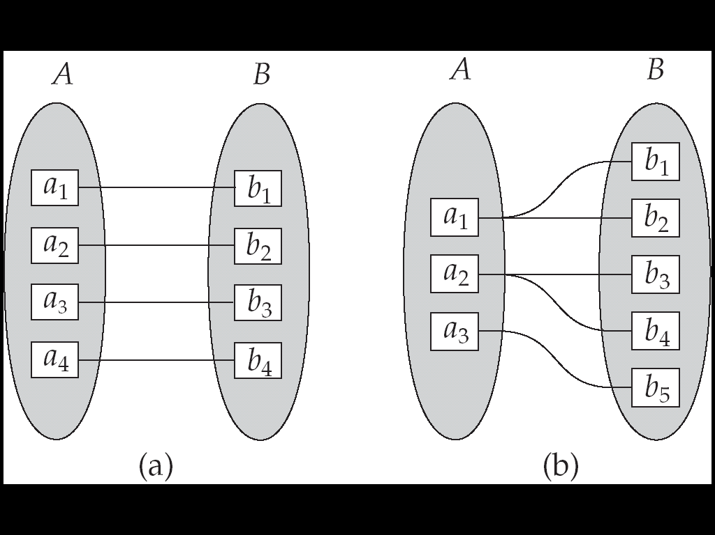
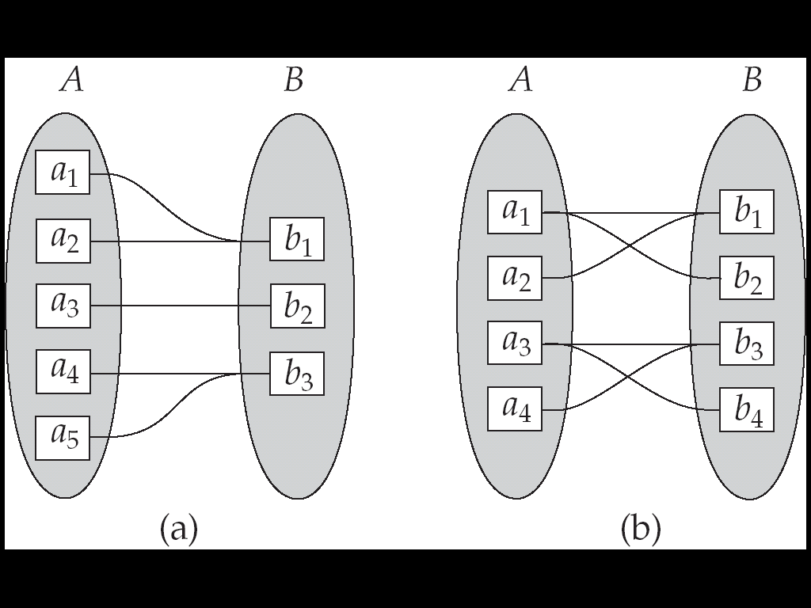
Mapping Cardinalities
One to one
One to many
Many to one
Many to many

Slide 25
Participation Constraints
Does every department have a manager?
If so, this is a participation constraint: the participation of Departments in Manages is said to be total (vs. partial).
Every Department entity must appear in an instance of the relationship Works_In (have an employee) and every Employee must be in a Department
Both Employees and Departments participate totally in Works_In
name
name
dname
since
dname
ssn
did
did
budget
lot
budget
Employees
Manages
Departments
Works_In
since
Notes:
8

Slide 26
Keys
A super key of an entity set is a set of one or more attributes whose values uniquely determine each entity.
A candidate key of an entity set is a minimal super key
Customer_id is candidate key of customer
account_number is candidate key of account
Although several candidate keys may exist, one of the candidate keys is selected to be the primary key.
Alternate key is the candidate key which are not selected as primary key.
Foreign key are the attributes of an entity that points to the primary key of another entity. They act as a cross-reference between entities.
Composite Key consists of two or more attributes that uniquely identify an entity. Non-key attributes are the attributes or fields of a table, other than candidate key attributes/fields in a table.
Non-prime Attributes are attributes other than Primary Key attribute(s)..

Slide 27
Relational Model
Example of tabular data in the relational model:

Slide 28
Relational Model (Basic)
The relational model used the basic concept of a relation or table.
Tuple:- A tuple is a row in a table.
Attribute:- An attribute is the named column of a relation.
Domain:- A domain is the set of allowable values for one or more attributes.
Degree:- The number of columns in a table is called the degree of relation.
Cardinality:- The number of rows in a relation,is called the cardinality of the relation.

Slide 29
Integrity Constraints
Integrity constraints guard against accidental damage to the database, by ensuring that authorized changes
to the database do not result in a loss of data consistency.
Domain Constraints:- It specifies that the value of each attribute x must be an atomic value from the domain of x.
Key Constraints:- Primary Key must have unique value in the relational table.
Referential Integrity:-It states that if a foreign key in table A refers to the primary key of table B then, every value of the foreign key in table A must be null or be available in table B.
Entity Integrity:- It states that no attribute of a primary key can have a null value.

