Slide 1
ESTIMATING AND COSTING OF DOMESTIC INSTALLATION
BASIC CONCEPTS AND IE RULES

Slide 4
DOMESTIC INSTALLATIONS
Electrical installations is used for both
Industrial and non industrial buildings.
Electrical networks in industrial buildings serve the purpose of distributing the required power to the consuming points where it is used for multitude of purposes in the industry.
(b) Non industrial buildings include domestic dwellings ,office,buildings,
shopping and commercial centres institutions, medical establishments, hotels and sports buildings etc.

Slide 5
WIRING ACCESSORIES
Fuse (Re-wirable fuse, MCB, etc)
Sockets & switches
Weatherproof cables
Ceiling rose
Ceiling plate
Pendant holder
Earthing thimbles
Combination switch plates
Junction boxes
Hand tools
PVC casing & caping
Fasteners
Distribution board
Protective devices like ELCB , Main switch , MCB etc

Slide 6
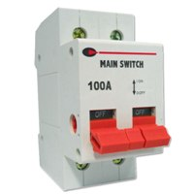
Main SWITCH
MAIN SWITCH – It is a control equipment which connect or disconnect the main supply. A iron clad main switch which operate phase & neutral simultaneously has a fuse and a neutral link. For single phase DPIC(Double pole iron clad) main switch with fuse and neutral link is used. For three phase TPIC(Triple pole iron clad) main switch with three fuse and neutral link is used.The rating for main switch for single phase supply is 5A, 10A, 15A, 30A upto 250 V. For three phase ratings are 30A, 60A, 100A, 200A, 300A upto 500V. The thick wire is used for the neutral link. The main switch rating is calculated by multiplying the full load current of a subcircuit by 1.5

Slide 7
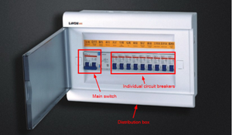
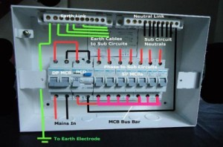
Distribution board
It is used to distribute the supply from the main circuit into various circuit & sub- circuits .

Slide 15
Selection of wire
Minimum size of cable or insulated wire for mechanical reasons.
Voltage drop
Current carrying capacity
Type of insulation used i.e. VIR, PVC, TRS etc.
Grade i.e. 250 volts, 500 volts, 660 volts grade etc.

Slide 16
Electrical wiring code
PVC insulated Aluminium conductor wire
OF size 1.5mm^2 or 1/1.40mm diameter
used for wiring light/fan/5amp. socket points.
(b) OF size 4mm^2 or 1/2.24mm diameter
used to wire 15 amp socket points.
(c) OF size 6mm^2 or 1/2.80 diameter used to wire 15 amp socket points to be used for geysers ,electric oven or other heavy loads.

Slide 18
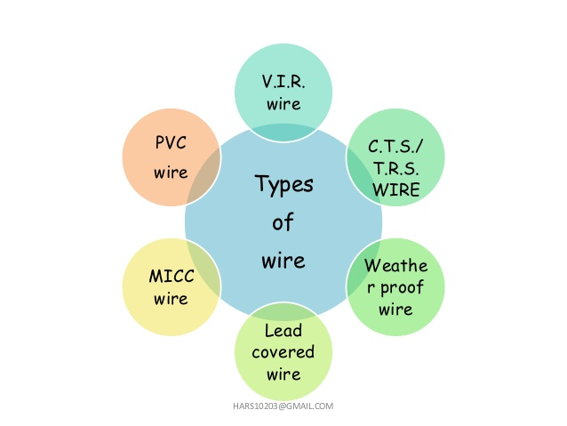

Slide 19
Sequence to be carried out for estimate.
Drawing the installation plan.
Calculation 0f total load in Amp.
Selection and rating of main switch & sub main switch
Selection & rating of main distribution board .
Calculation for the length of conduit pipe.
Calculation for the length of phase and neutral wire.
Calculation for the length of earth wire.
Preparing the material table.

Slide 20
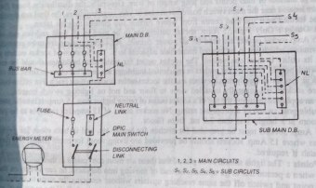

Slide 21
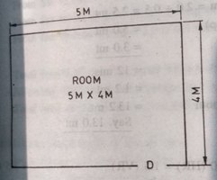
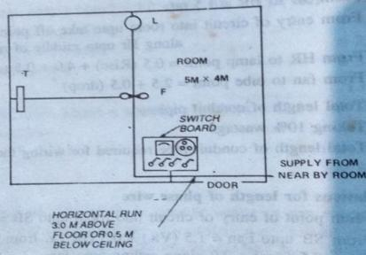
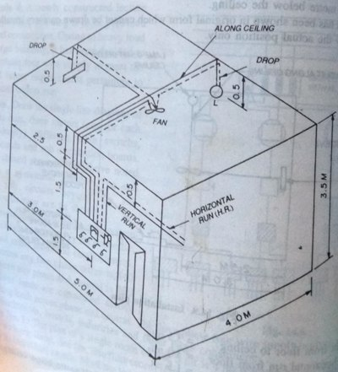

Slide 22
CALCULATION OF LOAD
Tube point - 1x40 = 40 watt
Lamp point – 1x100 = 100 watt
Fan point - 1x 60 = 60 watt
5 amp socket – 1x100= 100 watt
Total load in amperes = 300/230 = 1.3 A
Selection of main switch – Here a D.P.I.C Main switch of 5.Amp
Rating 250 volt grade is selected.

Slide 23
ASSUME
Total height from floor to ceiling = 3.5 mt.
Height of horizontal run from floor = 3.0 mt.
Height of switch board from floor = 1.5 mt.
Light and tube points from ceiling = 0.5 mt.
HR = Horizontal run i.e conduit running parallel to floor half metre below ceiling.
VR= Vertical run i.e wires or conduit running between switch board and HR.

Slide 24
CALCULATION FOR LENGTH OF CONDUIT PIPE OF 20mm diameter
From SB to HR = 1.5 mt.
From entry of circuit into room i.e along H.R upto middle
of room = 2.0 + 0.5 = 2.5 mt.
From H.R to Lamp point = 0.5(Rise) + 4.0 + 0.5(drop)
= 5.0 mt.
From fan to tube point = 2.5 + 0.5(drop) = 3.0 mt.
Total length of conduit pipe = 12mts.
Taking 10% wastage = 1.2 mt.
Total length of conduit pipe required for wiring the room
= 13.2 mt. say 13.0 mt.

Slide 25
CALCULATIONS FOR LENGTH OF PHASE WIRE
From point of entry of circuit into room upto SB = 2.0(H.R) +
1.5 (H.R) = 3.5 mt.
From SB upto fan = 1.5(V.R) + 0.5(H.R) + 0.5(rise) + 2.0 along ceiling upto fan = 4.5 mt.
From SB to lamp = 4.5 mt (upto fan) + 2.0 + 0.5(drop)
= 7.0 mt.
From SB to tube point = 4.5 upto fan + 2.5 upto ceiling + 0.5(drop) = 7.5 mt.
Total length of phase wire = 22.5 mts.

Slide 26
CALCULATION FOR LENGTH OF NEUTRAL WIRE
From point of entry of circuit into room upto switch board
= 2.0 along H.R + 1.5(V.R) = 3.5 mt.
From SB to fan = 1.5 + 0.5 + 0.5(rise) + 2.0 along ceiling
= 4.5 mt.
From fan to lamp point = 2.0(along ceiling) + 0.5(drop)
= 2.5 mt.
From fan to tube point = 2.5 + 0.5 (upto tube point)
= 3.0 mt.
Total length of neutral wire = 13.5 mts.

Slide 27
TOTAL LENGTH OF WIRE
Total length of wire required for wiring the room
(phase + neutral) = 22.5 mt. + 13.5 mt. = 36 mts.
Allowing 15% extra for wastage and connections
= 5.4 mt
Total wire required for wiring the room = 36.0 + 5.4 = 41.4 mts. say 41 mts.

Slide 28
CALCULATION FOR LENGTH OF EARTH WIRE
The earth terminal of the socket outlet is solidly connected to the switch board with a 14 SWG, earth wire through an earthing thimble.
Earth wire of 14 SWG (Say 0.25 mt) will serve the purpose.

Slide 29
LIST OF MATERIALS
Conduit pipe 20mm dia. Qty -13 mt.
PVC insulated, aluminium conductor, single core 250 volt grade of size 1.5mm^2 or 1/1.40 mm dia. Qty- 41mt.
Earth wire 14 S.W.G GI. Qty - 0.25 mt.
Iron clad, concealed type, switch boards, with bakelite sheets 20cm x 25cm. Qty – 1 No.
Conduit pipe accessories for 20mm dia conduit
1 way junction box. Qty - 2 Nos.
2 way junction box. Qty – 1 No.
3 way junction box. Qty – 2 Nos.
Conduit bends. Qty – 3 Nos.
Conduit nuts hexagonal to fix conduit with SB . Qty – 8 Nos.
Conduit sockets to connect two pieces of conduit. Qty – 8Nos.

Slide 30
LIST OF MATERIALS
Switch, 5 amp rating. Qty – 4 Nos.
Socket , 5 amp rating . Qty – 1 No.
Ceiling roses, 2 – plate, bakelte. Qty – 2 Nos.
Junction box covers. Qty – 2 N0s.
Lamp brass bracket with holder. Qty – 1 No.
Earthing thimbles. Qty – 1 No.
Hexagonal headed bolt and nut 6 mm dia. 25mm long for fixing earthing thimbles with switch board
Qty- 1 No.
Labour charges @ 20.00 per point for 4 points
Miscellaneous expenses @ 10% of total cost.
(including supervision charges)
Apply the suitable rates for the materials and the calculate the -
Total cost of wiring Rs________

