Slide 1
ELECTRICAL MACHINE-I
UNIT-04
AUTO TRANSFORMER
POWER TRANSFORMER
DISTRIBUTION TRANSFORMER

Slide 2
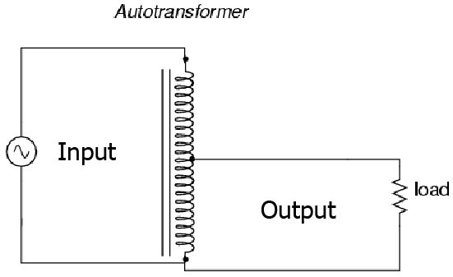
AUTO-TRANSFORMERS
An autotransformer (sometimes called auto step down transformer)is an electrical transformer with only one winding. The "auto" (Greek for "self") prefix refers to the single coil acting on itself and not to any kind of automatic mechanism.

Slide 3
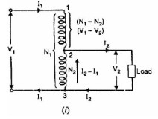
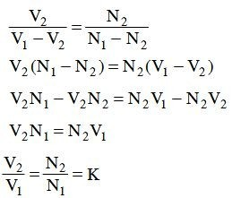
Theory of Autotransformer
N1=primary turn(1-3)
N2=secondary turn(2-3)
I1=primary current
I2=secondary current
V1=primary voltage
V2=secondary votage
From the above fig. We get

Slide 4
OUT PUT:- The primary and secondary windings of an autotransformer are Connected magnetically as well as electrically. So the power transferred primary to secondary inductively as well as conductively

Slide 5
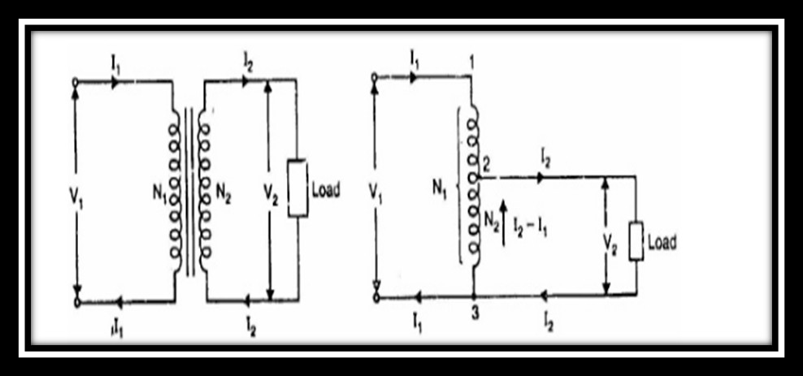
Copper saving in Auto transformer
The same output and voltage transformation ratio an autotransformer requires less copper than the 2-winding transformer

Slide 6
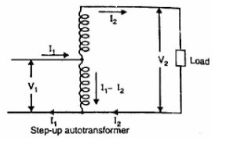
Types of AUTO Transformer:- Step UP Transformer :-
A transformer in which Ns>Np is called a step up transformer. A step up transformer is a transformer which converts low alternated voltage to high alternated voltage

Slide 7
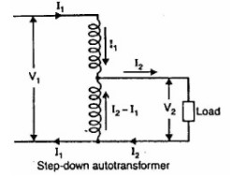
Step DOWN Auto Transformer :-
A transformer in which Np>Ns is called a step down transformer. A step down transformer is a transformer which converts high alternating voltage to low alternating voltage.

Slide 8
Advantages
An autotransformer requires less Cu than a two- winding transformer of similar rating.
An autotransformer operates at a higher efficiency than a two-winding transformer of similar rating.
An autotransformer has better voltage regulation than a two-windingtransformer of the same rating.
An autotransformer has smaller size than a two- winding transformer of the same rating.
An autotransformer requires smaller exciting current than a two-windingtransformer of the same rating.

Slide 9
DISADVANTAGES
There is a direct connection between the primary and secondary. Therefore, the output is no longer d.c. isolated from the input.
An autotransformer is not safe for stepping down a high voltage to a low voltage. As an illustration.
If an open circuit develops in the common portion of the winding, then full-primary voltage will appear across the load. In such a case, any one coming in contact with the secondary is subjected to high voltage. This could be dangerous to both the persons and equipment. For this reason, autotransformers are prohibited for general use.
The short-circuit current is much larger than for the two-winding transformer of the same rating. So that a short-circuited secondary causes part of the primary also to be short-circuited. This reduces the effective resistance and reactance

Slide 10
APPLICATION
Autotransformers are used to compensate for voltage drops in transmission and distribution lines. When used for this purpose, they are known as booster transformers.
Autotransformers are used for reducing the voltage supplied to a.c. motors during the starting period.
Autotransformers are used for continuously variable supply
Autotransformers are used to compensate for voltage drops in transmission and distribution lines. When used for this purpose, they are known as booster transformers.
Autotransformers are used for reducing the voltage supplied to a.c.motors during the starting period.
Autotransformers are used for continuously variable supply
In control equipment for 1-phase and 3- phase electrical locomotives.

Slide 11
Power Transformer
The Power Transformer is installed at various power stations for generation and transmission of power. It acts as a step-up or a step-down transformer for increasing and decreasing of the level of voltages as per the requirement, and it’s also used as an interconnection between two power stations
Distribution Transformer
The Distribution Transformer is used to bring down or step down the voltage and current level of a transmission line to a predefined level, which is called safety level for the end user consumer in domestic and industrial purpose.

Slide 12
Difference Between Power Transformer and Distribution Transformer
Power transformers are used in transmission network of higher voltages whereas the Distribution Transformers are used in the distribution network of lower voltages.
The power transformers are available in various ratings of 400 KV, 200 KV, 110 KV, 66 KV, 33 KV in the market and the distribution transformer are available in 11 KV, 6.6 KV, 3.3 KV, 440 V, 230 Volts.
The power transformer always operates on rated full load as the load fluctuation is very less but the distribution transformer is operated at the load less than full load as the variation in the loads are very high.

Slide 13
Power transformers are used in power generating stations and transmission substations, and the distribution transformer is installed at the distribution stations from where the power is distributed for the industrial and domestic purposes.
The size of the power transformer is large as compared to the distribution transformers.
In Power Transformer, the iron and copper losses take place throughout the day but in distribution transformer the iron loss takes place 24 hours i.e., throughout the day, and the copper losses depend on the load cycle.
The power transformers are designed for maximum efficiency of 100%, and the efficiency is simply calculated by the ratio of output power to the input power, whereas the distribution transformer the maximum efficiency varies between 50-70% and calculated by All Day Efficiency.

